Slide 1
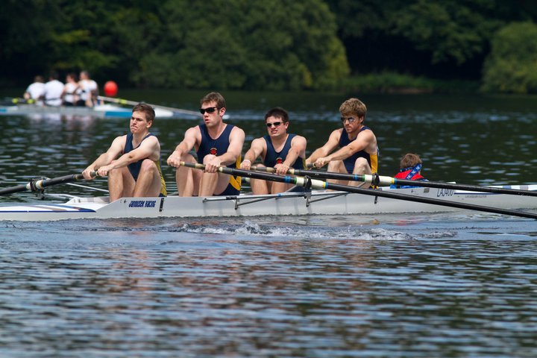


Periodised Training Programme for Rowing
Lancaster John O’ Gaunt Rowing Club
Lancaster Schools’ Rowing Association
Test
Training Zones
Amount of Training
Select Workout
Select Split
Complete Workout
Complete Weekly Workouts
Training Load
4 Week Cycle of Loading
Failure to Complete
Water Sessions
My Own Workouts
Active Rest

Slide 2
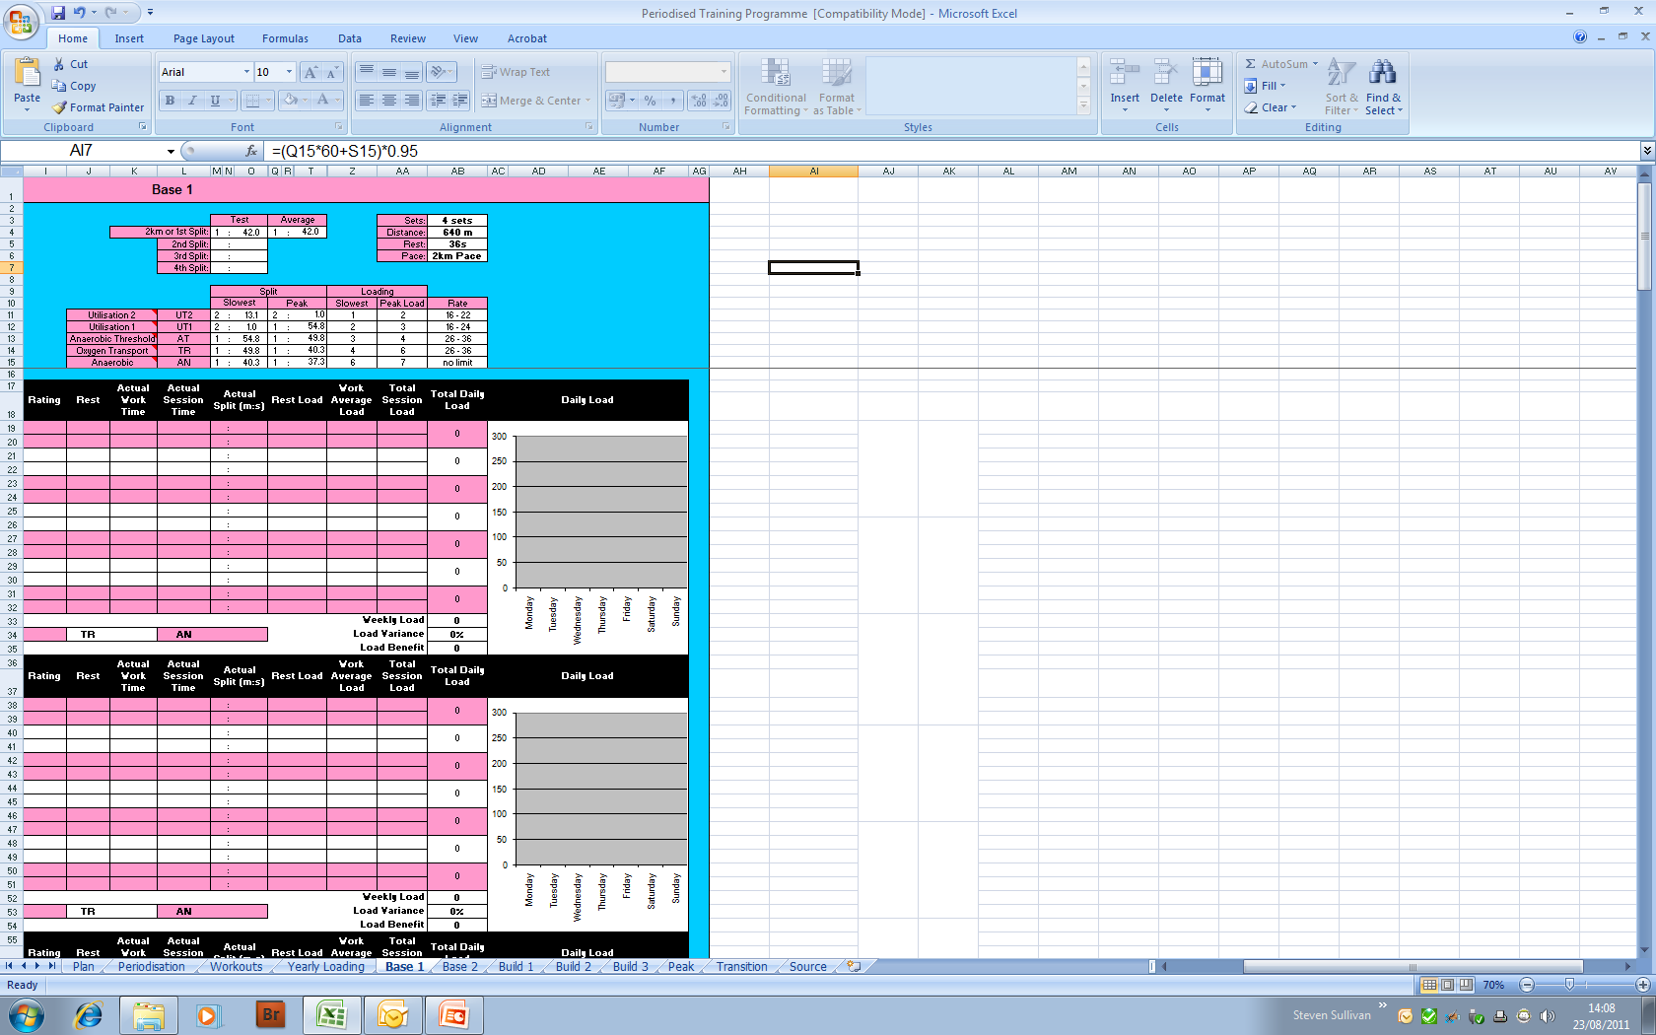
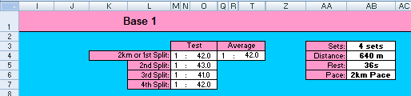
Test
1. Test
Lancaster John O’ Gaunt Rowing Club
Lancaster Schools’ Rowing Association
First of all complete either a 2km test or a 2km predictor test.
Format for 2km Predictor:
  Complete 4 sets of 640m with 36seconds rest
  Tests will give 5 Training Zones to work in
Standard 2km Test
2km Predictor
Training Zones

Slide 3
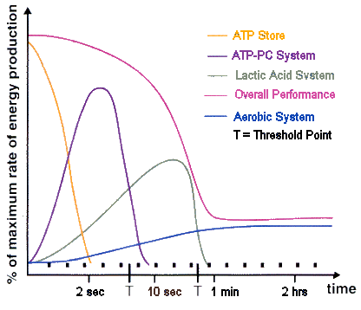
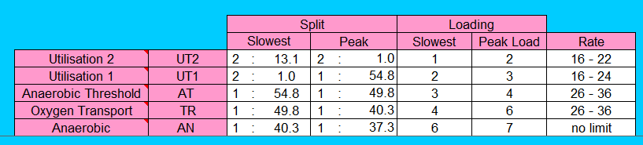
Training Zones
2. Training Zones
Lancaster John O’ Gaunt Rowing Club
Lancaster Schools’ Rowing Association
5 Training Zones:
Training Zone | % MHR | Lactate | Benefit
Utilisation 2 (UT2) | 55-70 |  | Increase Cardiovascular Endurance (Increases Fat metabolism and develops capillary beds to the working muscles – most physiological benefit from on-water rowing )
Utilisation 1 (UT1) | 70-80 |  | Increase Cardiovascular Endurance (Improve the body’s ability to transport oxygen to and carbon dioxide away from the working muscles)
Anaerobic Threshold (AT) | 80-85 |  | Increase Muscular Endurance (Delay onset of Lactic Acid accumulation)
Oxygen Transport (TR) | 85-90 |  | Increase Strength (Increases ability of the heart to pump more blood around the body)
Anaerobic (AN) | 90-100 |  | Increase Power (Improves Lactate Acid removal and Lactate Acid Tolerance)

Slide 4
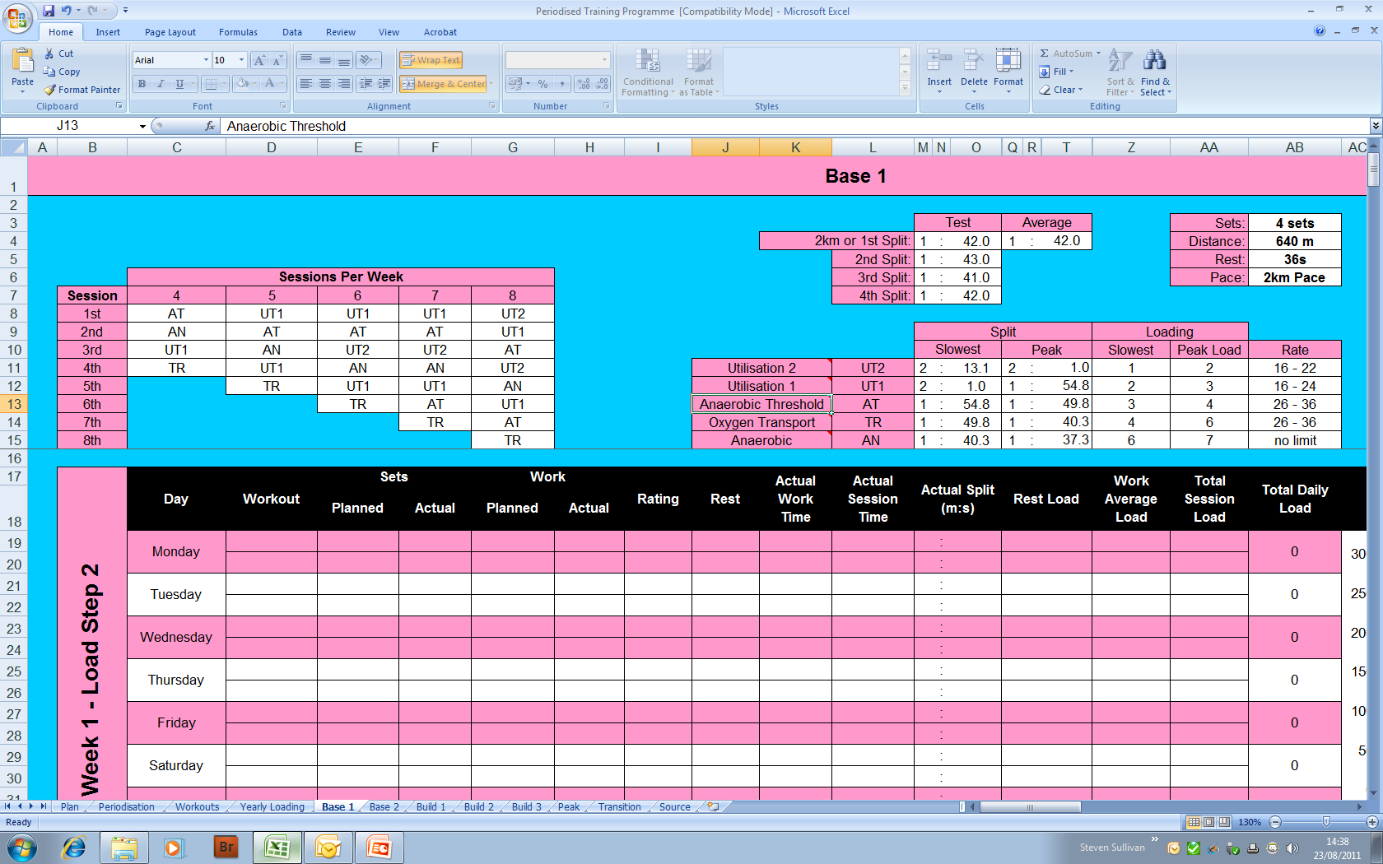
Amount of Training
3. Amount of Training
Lancaster John O’ Gaunt Rowing Club
Lancaster Schools’ Rowing Association
You will need to select how many workouts that you can realistically complete during a week – this will dictate the type of workouts that you will complete during the week.

Slide 5
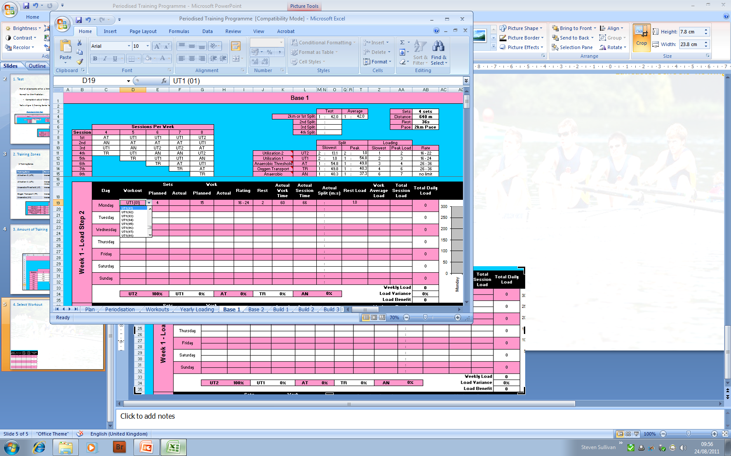
Select Workout
4. Select Workout
Lancaster John O’ Gaunt Rowing Club
Lancaster Schools’ Rowing Association
Decide how many sessions you want to complete a week; the table on the left indicates the training band of each daily session.
Select a training session from the workout dropdown list; this will automatically populate the rest of the row.
The session selected in this example is UT1 (01) – the lower the number in brackets the longer the work period.
This workout is 4 sets of 15 minutes at rating 16-24 with 2 minutes of active rest in-between each work period.

Slide 6
Select Split
5. Select Split
Lancaster John O’ Gaunt Rowing Club
Lancaster Schools’ Rowing Association
From the previous page the workout that was selected was UT1 (01)
Prior to starting the workout identify the split that you should be working at in the UT1 zone – in this example the athlete should be working between 1:54.8 and 2:01.0.

Slide 7
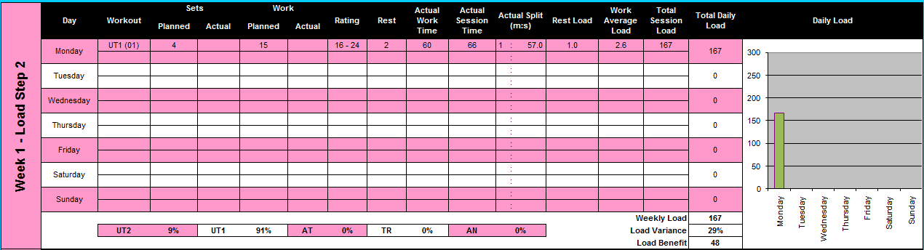
Complete Workout
6. Complete Workout
Lancaster John O’ Gaunt Rowing Club
Lancaster Schools’ Rowing Association
Once you have completed the workout record the average split for all workouts in the “Actual Split” columns.
In the “Total Session Load” column a loading value is given – in this case it is 167, which is also displayed in the chart to the right.

Slide 8
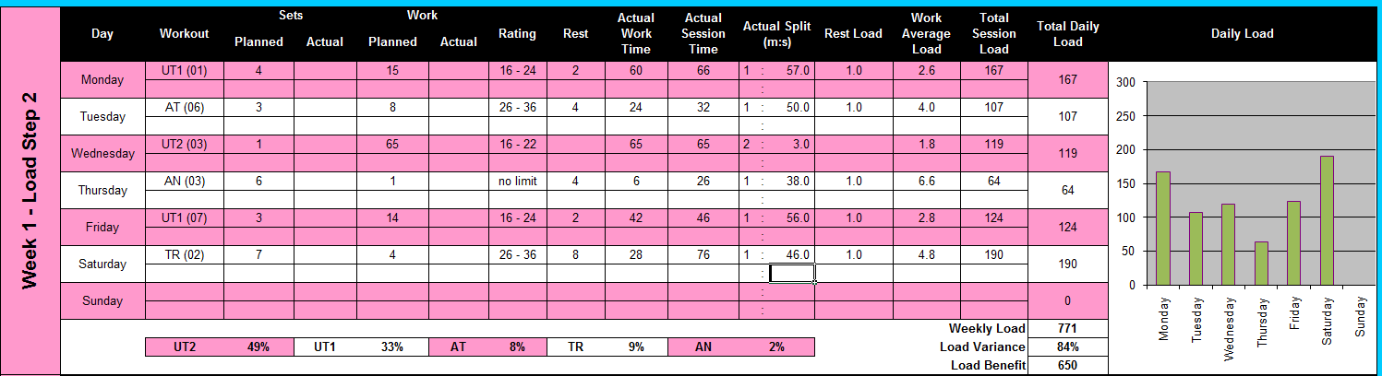
Complete Weekly Workouts
7. Complete Weekly Workouts
Lancaster John O’ Gaunt Rowing Club
Lancaster Schools’ Rowing Association
Work your way through the week making sure that you are using sessions from within each training zone as indicated in the table on the left.

Slide 9
Training Load
8. Training Load
Lancaster John O’ Gaunt Rowing Club
Lancaster Schools’ Rowing Association
By varying the workouts you complete during the week you will not only maximise physiological training gains but you will have more interest in continuing to train.
When deciding on which session to complete for each training zone ensure that you vary the number that you pick from within the brackets. By doing this you will create “Load Variance”, or even greater variety to your sessions.

Slide 10
Weekly Models of Training Load
9. Weekly Models of Training Load
Lancaster John O’ Gaunt Rowing Club
Lancaster Schools’ Rowing Association
This chart shows different ways to structure your week in terms of loading. Try to maintain a four weekly cycle of loading – step 2 (medium), step 3 (hard), step 4 (maximum) and week 4 (light).
Week 1: Alternative loading, suitable for beginners
Week 2: Front Loading, suitable for a race week
Week 3: End Loading, suitable for a high loaded week
Week 4: Pyramid Loading, suitable for a light week

Slide 11
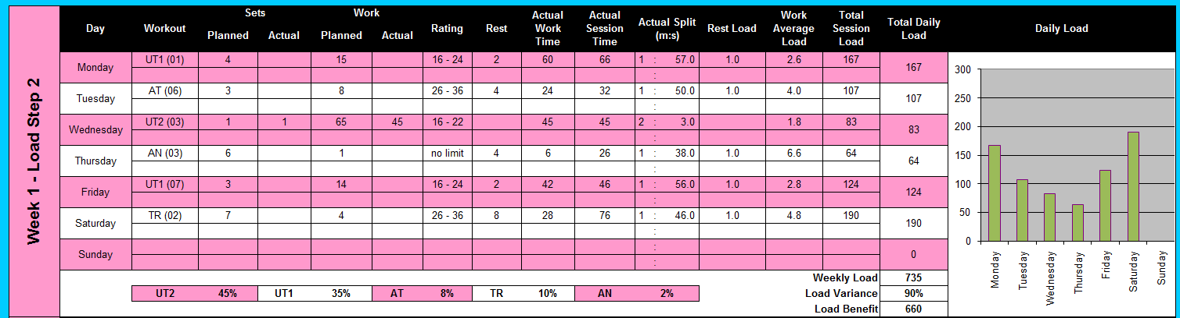
Failure to Complete
10. Failure to Complete
Lancaster John O’ Gaunt Rowing Club
Lancaster Schools’ Rowing Association
If you have started a session and find that you are unable to complete then change the details for the session in the spreadsheet.
On Wednesday of the week above the athlete was unable to complete the session – they completed 1 set of 45 minutes instead of 1 set of 65 minutes – in the “Sets Actual” the athlete has inputted 1 and in “Work Actual” the athlete has inputted 45 minutes.

Slide 12
Water Sessions
11. Water Sessions
Lancaster John O’ Gaunt Rowing Club
Lancaster Schools’ Rowing Association
This document can be used to log water sessions – the main difference is that your effort is not recorded. Use your intuition to estimate how hard your session was, input an approximation of what your split would have been had the session been on an indoor rowing machine.

Slide 13
My Own Workouts
12. My Own Workouts
Lancaster John O’ Gaunt Rowing Club
Lancaster Schools’ Rowing Association
If you want to make your own workouts then use the workout list to pick a session that is close to the one that you want to do and adapt it using the “Actual” boxes.
On the Wednesday above the athlete only had 45 minutes to complete a UT2 session, the athlete inputted UT2 (03) in the “Workout” cell and changed the “Sets Actual” and “Work Actual” to meet his requirements.

Slide 14
Active Rest
13. Active Rest
Lancaster John O’ Gaunt Rowing Club
Lancaster Schools’ Rowing Association
“Rest” is supposed to be active rest.
When completing an interval session with rest take the opportunity to grab a drink and quickly stretch.

